Slide 1
Building Event-Driven Microservices with the Serverless Framework
Srini Karlekar – Director, Software Engineering, Capital One.
Twitter: @skarlekar

Slide 2
The momentum behind serverless
The introduction of function PaaS (fPaaS¹) by AWS Lambda in re:Invent, Nov 2014 (and out of beta in late 2015) created a momentum for "serverless" platform architecture. AWS Lambda was soon followed by most major cloud platform vendors, including IBM, Microsoft, Google and, more recently, Oracle. Serverless is a cloud-native platform model.
Per Gartner, by 2022 most cloud architectures will evolve to a fundamentally serverless model rendering the cloud platform architectures dominating in 2017 as legacy architectures².
Serverless is a cloud-native platform model and reflects the core-promise of cloud-computing by offering agility and capability on demand at a value price.
Amazon started the trend with Lamda

Slide 3
Serverless Architecture vs. serverless Framework
Serverless computing model is an emerging trend and quite often misunderstood because of the hype and build-up surrounding the topic.
The term Serverless refers to building applications without having to configure or maintain infrastructure required for running your applications.
In reality, servers are still involved, though they are owned and controlled by the platform providers.
On the other hand there are frameworks used for exploiting the serverless architecture uninspiringly named Serverless Framework increasing the confusion.
No need to configure or maintain infrastructure

Slide 4

Serverless Architecture

Slide 5
What is Serverless
Serverless Architectures are those models where the applications logic provided by the Developer is run on stateless, compute containers that are provisioned and managed by a provider.
Typically these compute instances are ephemeral (short-lived for the duration of the request-response cycle), typically runs a function and triggered through an event.
Due to the on-demand provisioning nature of this architecture, the systems built using Serverless technologies are inherently scaleable and highly responsive under load.
Functions are ephemeral and triggered via an event

Slide 6
Function as a Service (Faas)
The technique of building applications using Serverless architecture is known as FaaS (Function as a Service).
The reason becomes clear when you contrast FaaS applications with the traditionally built applications or PaaS (Platform as a Service) where there is a perpetual process running on a server waiting for HTTP requests or API calls.
In FaaS there is no perpetual process (for the most part) but an event mechanism that triggers the execution of a piece of code, usually just a function. You still need a perpetual gateway that will field your API calls to start the events to cascade.
The other key operational difference between FaaS and PaaS is scaling. With most PaaS solutions you still need to worry about scale. With FaaS the compute resources are provisioned at a request level. You cannot get the same level of granularity with PaaS applications even if you set it to auto-scale.
As a result of this, FaaS applications are extremely efficient when it comes to managing cost.
FaaS – Applications Built with Serverless Architecture

Slide 7
Limitations of Faas – State & Duration
State - Due to the ephemeral nature of the FaaS architecture, the state of your application should be managed externally from the FaaS infrastructure or off-loaded to a cache or data-base. This could be very limiting for certain type of applications running on thin clients or untrusted devices where the application orchestration has to extend through multiple request-response cycles.
Duration - Because of the on-demand provisioning and low-cost nature of the FaaS solution there is a restriction on how long your functions are allowed to run. To keep the price low - as you are billed by minutes of usage, some providers such as Amazon AWS and Microsoft Azure restrict the duration of time a function is allowed to process a request.
State between Requests must be maintained outside of FaaS

Slide 8
Limitations of Faas - Resource limits
Deployment & Resource Limits - Some providers such as AWS have deployment limits on the size of the deployment package, code and libraries that can be deployed in the package.
This could be severely limiting for some applications such as image processing functions that depend on large libraries that have to be packaged along with the code.
Additionally, there are limits on the number of concurrent function executions, ephemeral disk capacity (temp space) etc.
While some of these limits are soft limits and can be reconfigured per function by working with the providers, others are hard limits and will force you to reevaluate the choice of your design.
Resources are limited – Use Wisely

Slide 9
Limitations of Faas - Latency
Latency - Due to the on-demand provisioning nature of the FaaS infrastructure, applications that uses languages such as Java/Scala that require a long start time to spin up JVMs may encounter longer runtime.
Having said that, providers optimize the infrastructure spin-ups based on the usage patterns of the functions.
On the other hand, due to the interpreted nature of Python and Javascript, functions written in these languages may not see a significant difference in latency between a PaaS and FaaS offering.
Test the performance of your applications thoroughly

Slide 10
The players
While there are new providers entering the market to exploit the Serverless wave, the following rule the roost:
Amazon with its AWS Lambda,
Microsoft with its Azure Functions,
Google with its Google Functions and
IBM with its Openwhisk.
Amazon’s AWS Lambda is the dominant player

Slide 11
Serverless framework

Slide 12
Drivers for a Framework
Organizations want to diversify risk and hence do not want to be bound to a single provider.
While not having to manage infrastructure by using serverless functions is nice, having to deal with hundreds of functions in a project between multiple providers, managing buckets, messaging and permissions becomes an issue in itself.
While many providers are entering into the Serverless field to make developing cloud-native applications easy, you are still bound to idiosyncrasies of the provider when it comes to their FaaS offering.
Not only do you have to learn the different terminologies used by the various providers, you will have to learn how to use their offerings on their respective consoles or CLI (Command Line Interface).
Too many cooks spoil the broth

Slide 13
Serverless Framework to the rescue
The Serverless Framework is an MIT open-source project, actively maintained by a vibrant and engaged community of developers and provides robust plugins for various FaaS providers and allows to extend it when needed.
The Serverless Framework allows you to provision and deploy REST APIs, backend services, data pipe-lines, and other uses cases by providing a framework and CLI to build serverless services across many providers by abstracting away provider-level complexity.
The Serverless Framework is different than other application frameworks because:
It manages your code as well as your infrastructure
It supports multiple languages (Node.js, Python, Java, and more)
Serverless framework allows choice of FaaS providers across a single project

Slide 14
Core Concepts of Serverless FrameWORK
Serverless Framework consists of the following core concepts:
Service
Function
Events
Resources
Plugins

Slide 15
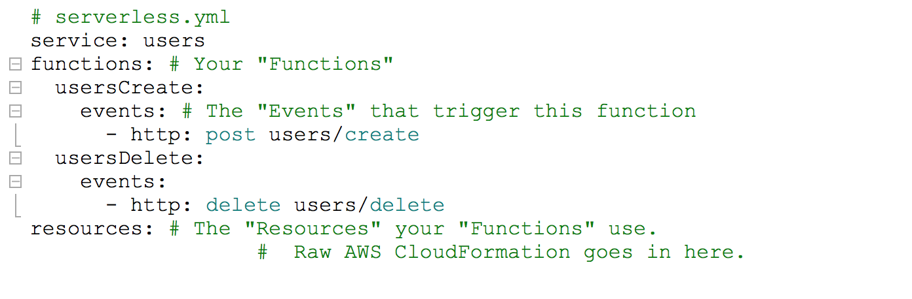
Services
Service - The unit of organization. It's where you define your Functions, the Events that trigger them, and the Resources your Functions use, all in one file titled serverless.yml. More information at: https://goo.gl/9SKBvx
An application can have multiple services and hence multiple serverless.yml files.

Slide 16
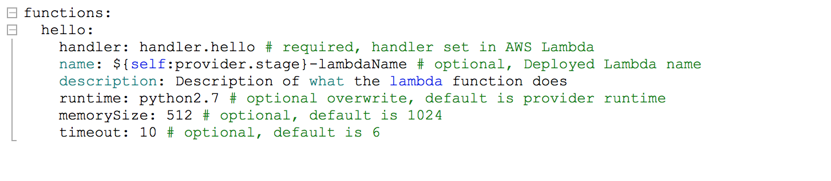
Functions
Functions - A Function is an independent unit of deployment or microservice. It manifests itself as a Lambda or Azure Function depending upon the provider. It's merely code, deployed in the cloud, that is most often written to perform a single job such as:
Saving a user to the database
Processing a file in a database
Performing a scheduled task

Slide 17
Events
Anything that triggers an Function to execute is regarded by the Framework as an Event.
Events are infrastructure events on AWS such as:
An AWS API Gateway HTTP endpoint request (e.g., for a REST API)
An AWS S3 bucket upload (e.g., for an image)
A CloudWatch timer (e.g., run every 5 minutes)
An AWS SNS topic (e.g., a message)
A CloudWatch Alert (e.g., something happened)
When you define an event for your functions in the Serverless Framework, the Framework will automatically create any infrastructure necessary for that event (e.g., an API Gateway endpoint) and configure your Functions to listen to it.

Slide 18
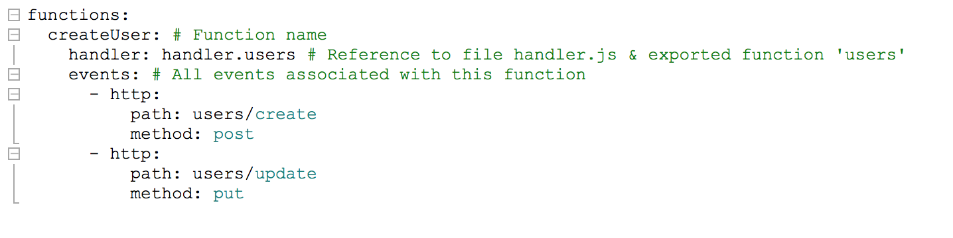
Events
Simply put, events are the things that trigger your functions to run. If you are using AWS as your provider, all events in the service are anything in AWS that can trigger an AWS Lambda function, like an S3 bucket upload, an SNS topic, and HTTP endpoints created via API Gateway.
Upon deployment, the framework will deploy any infrastructure required for an event (e.g., an API Gateway endpoint) and configure your function to listen to it.

Slide 19
Resources
Resources are infrastructure components which your Functions uses.
If you use AWS as you provider, then resources are:
An AWS DynamoDB Table (e.g., for saving Users/Posts/Comments data)
An AWS S3 Bucket (e.g., for saving images or files)
An AWS SNS Topic (e.g., for sending messages asynchronously)
Anything that can be defined in CloudFormation is supported by the Serverless Framework
The Serverless Framework not only deploys your Functions and the Events that trigger them, but it also deploys the infrastructure components your Functions depend upon.

Slide 20
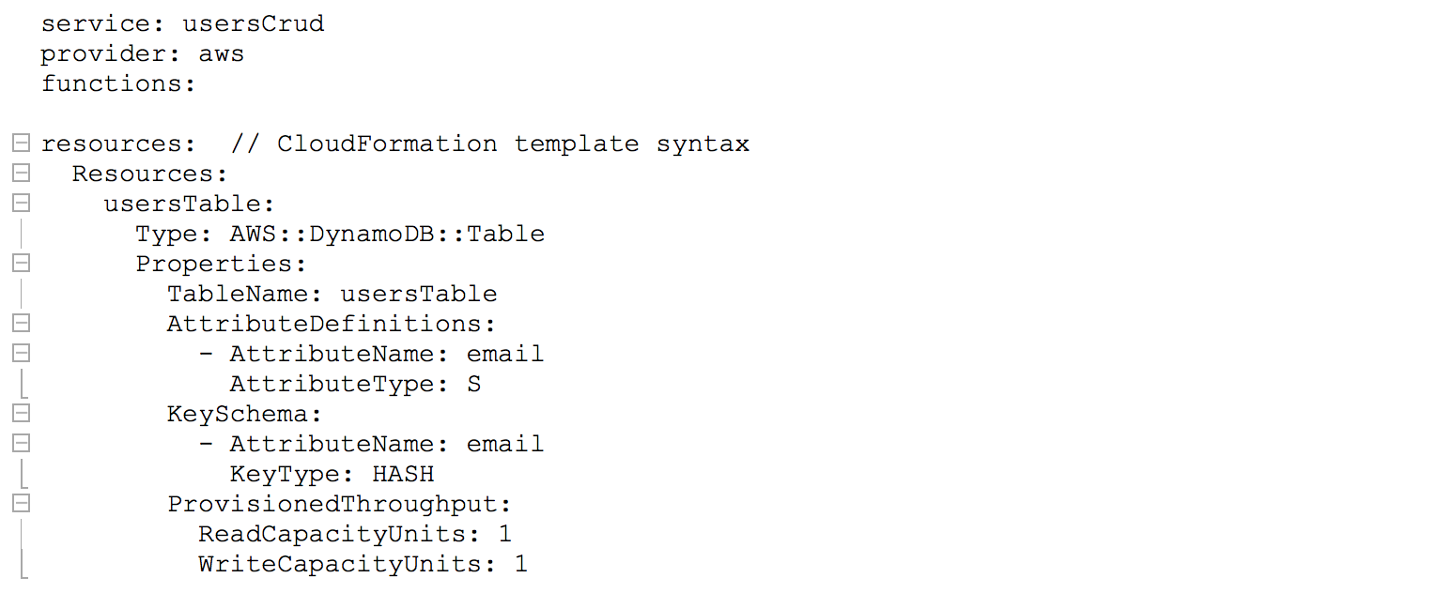
Resources
An example of resources in Serverless Framework using AWS as provider:

Slide 21
Credentials
Serverless Framework needs access to your cloud provider account credentials to deploy resources on your behalf. For AWS you can use AWS CLI (aws configure). Azure is more involved.
Following links provide excellent guidance on setting up the credentials for various providers currently supported on the Serverless Framework.
AWS - https://serverless.com/framework/docs/providers/aws/guide/credentials/
Azure -https://serverless.com/framework/docs/providers/azure/guide/credentials/
Openwhisk - https://serverless.com/framework/docs/providers/openwhisk/guide/credentials/

Slide 22
Deployment
Serverless Framework translates the service declaration in the serverless.yml file into a Cloud Formation or Resource Manager template depending upon the provider you choose.
To deploy your service, all the functions and provision the resources, enter:
serverless deploy --verbose
To deploy a single function after making changes to it, enter:
serverless deploy function --function <myfunction> --verbose

Slide 23
Invoking
Serverless Framework allows you to invoke a function locally for testing or invoke a deployed function.
To invoke your function locally, enter:
serverless invoke local --function <myfunction> --log
To invoke a deployed function, enter:
serverless invoke function --function <myfunction> --stage <my stage> --region <myregion>
Note: If you omit the stage and region option, the default stage (dev) and region specified in your provider configuration will be used.

Slide 24
Celebrity Sleuth - Application DEMO

Slide 25
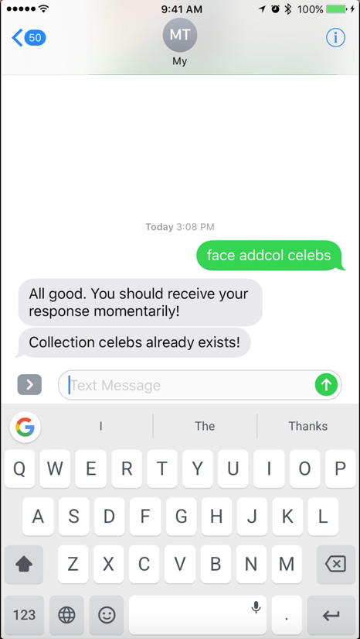
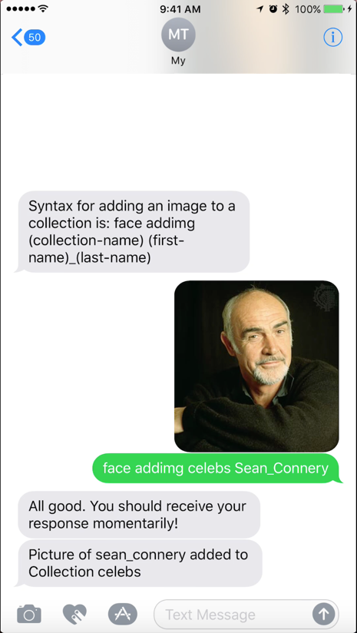
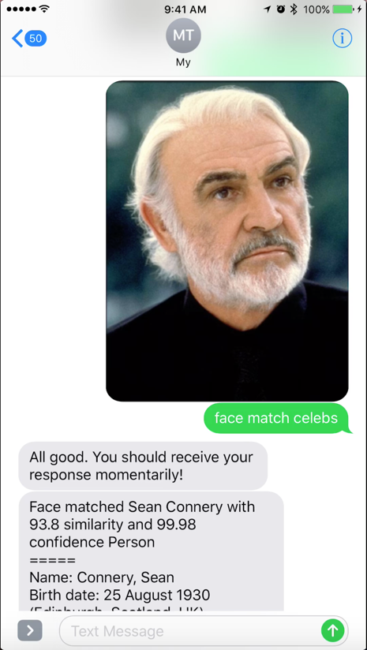
Celebrity Sleuth - SCreenshots
Create new Database
Train
Perform

Slide 26
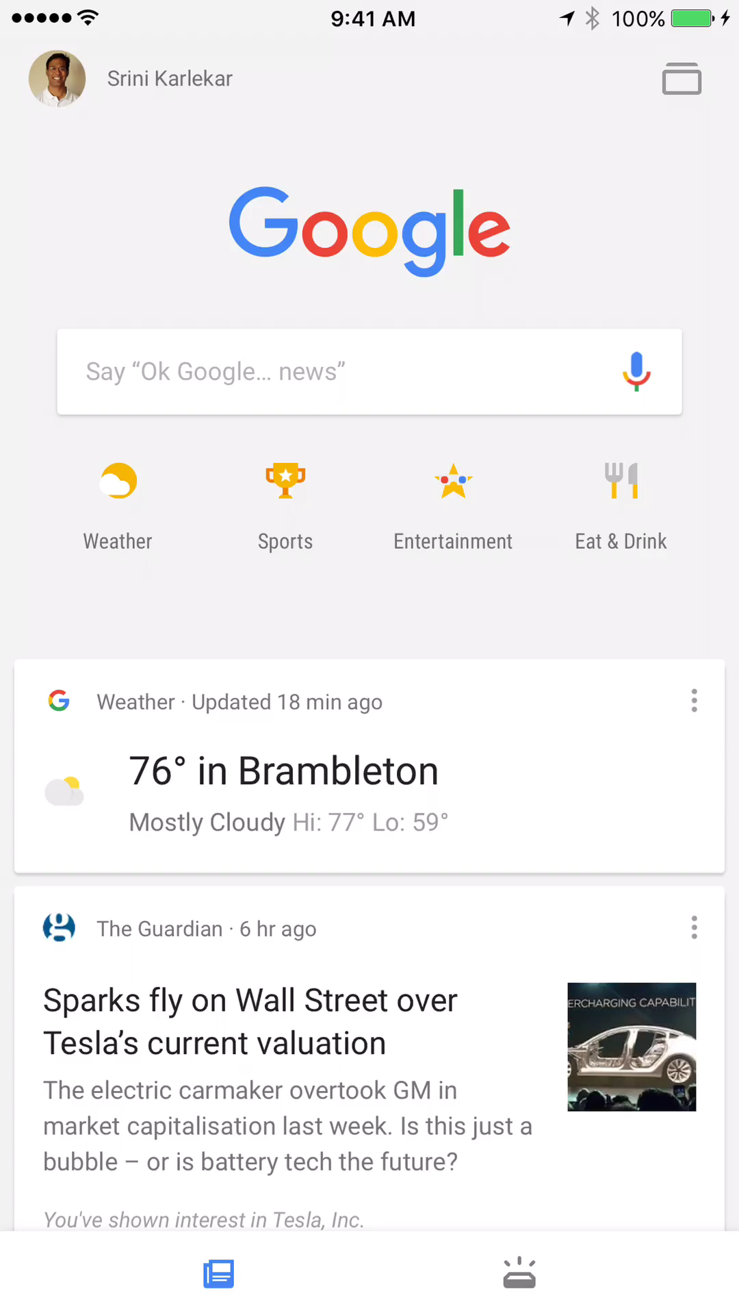
Celebrity Sleuth – Pre-Recorded Demo

Slide 27
Celebrity Sleuth – LIVE Demo

Slide 28
Celebrity Sleuth

Slide 29
Celebrity Sleuth - Sample Application
A celebrity face recognition service built with Serverless Framework using Twilio, Amazon Rekognition and IMDbPy API.
The CelebritySleuth application is an event-driven application taking advantage of:
The user's mobile SMS/MMS for the presentation tier,
Twilio in the middle-tier to bridge the SMS world and
AWS Gateway and a set of AWS Lambda functions written in Python making use of AWS Rekogniton for image processing and IMDB for gathering information on the celebrities.
CelebritySleuth code repository, installation guide and usage at:
https://github.com/skarlekar/faces

Slide 30
Celebrity Sleuth - Continued
To begin with you have to train the application to recognize the faces by building a collection of celebrities. You do this by sending a random sample of celebrity pictures (image URLs) and their corresponding names. The more pictures of a celebrity, the more accurate the recognition will be.
The CelebritySleuth application consists of two services:
Twilio Communication Service
Face Recognition Service
The services are decoupled to allow for using different presentation tiers in future.

Slide 31
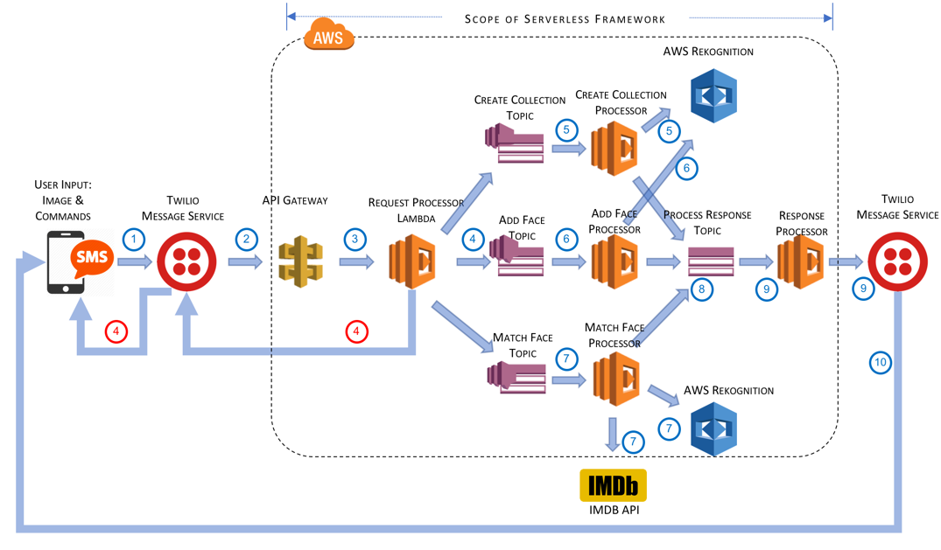
Celebrity Sleuth - Architecture

Slide 32
Celebrity Sleuth – Data Flow
User sends a picture and commands to add/match face to a collection. Alternatively, the user can create a collection – in which case a picture is not required. The SMS/MMS is sent to a telephone number hosted by Twilio.
Twilio intercepts the message and forwards it to an API Gateway based on the user’s Twilio configuration.
API Gateway translates TwiML to JSON and calls the Request Processor lambda function.
The Request Processor lambda validates the commands and put a message to the appropriate topic on SNS. If the validation fails, it returns the error message to the user via Twilio.
When a message arrives in the Create Collection topic, a lambda is triggered which adds the named collection in AWS Rekognition via Boto libraries. A success/error message is put in the Response Processor topic.
When a message arrives in Add Face topic, a lambda is triggered which identifies the most prominent face in the image and adds the metadata for the face to the given collection. If there is no faces identified, it creates an error message and sends the response to the Response Processor topic.
When a message arrives in Match Face topic, a lambda is triggered which identifies the most prominent face in the image and matches the metadata for that face with known faces in the collection. If a match is found, the corresponding person’s name is returned. The Lambda then uses IMDB to lookup the biography of the person.
The various lambda-based processors drops the response message on the Response Processor topic.
The Response Processor picks up the response and constructs a SMS message and calls Twilio’s SMS service.
Twilio validates the From number and sends the message to the corresponding To number.

Slide 33
Celebrity Sleuth – Code Walk-Through
The CelebritySleuth application can be cloned from:
https://github.com/skarlekar/faces
The two main services are:
Twilio Communication Service - https://github.com/skarlekar/faces/tree/master/twilioCommunicationService
Face Recognition Service – https://github.com/skarlekar/faces/tree/master/faceRecognitionService

Slide 34
Celebrity Sleuth – Next Steps
Security – Wrap a security blanket around twilioCommunicationService such that only authorized users are allowed to call the service. More information at: https://www.twilio.com/docs/api/security#http-authentication
Validation – In addition to the security blanket above, validate that the twilioCommunicationService is called only from Twilio. More information at: https://www.twilio.com/docs/api/security#validating-requests
VPC – As the faceRecognitionService is an internal service, secure it within a VPC. More information at: https://serverless.com/framework/docs/providers/aws/guide/functions#vpc-configuration

